Slide 1
Visual Analytics– Visualization 101
Dr. Ab Mosca (they/them)
Slides based off slides courtesy of Jordan Crouser (https://jcrouser.github.io/)

Slide 2
Plan for Today
Visualization overview
Graphical primitives
Visual dimensions
Common visualization techniques
Time permitting: Tableau demo

Slide 3
Reminder
hw01 is released today! (https://amosca01.github.io/SDS-CS235/ > Homework > hw01)
Due next Thursday (09/19) at midnight
You have extensions if you need them, but you MUST tell me if you’re taking one
Revise and resubmit also exists!
Work with a small group (3-4) – I recommend finding people with complementary skillsets to work with
**I won’t always remind you there is a homework released/due, make sure you stay up to date with the course schedule! **

Slide 4

Visual Analytics
$\text{Visualization} ∩$ Analysis

Slide 5
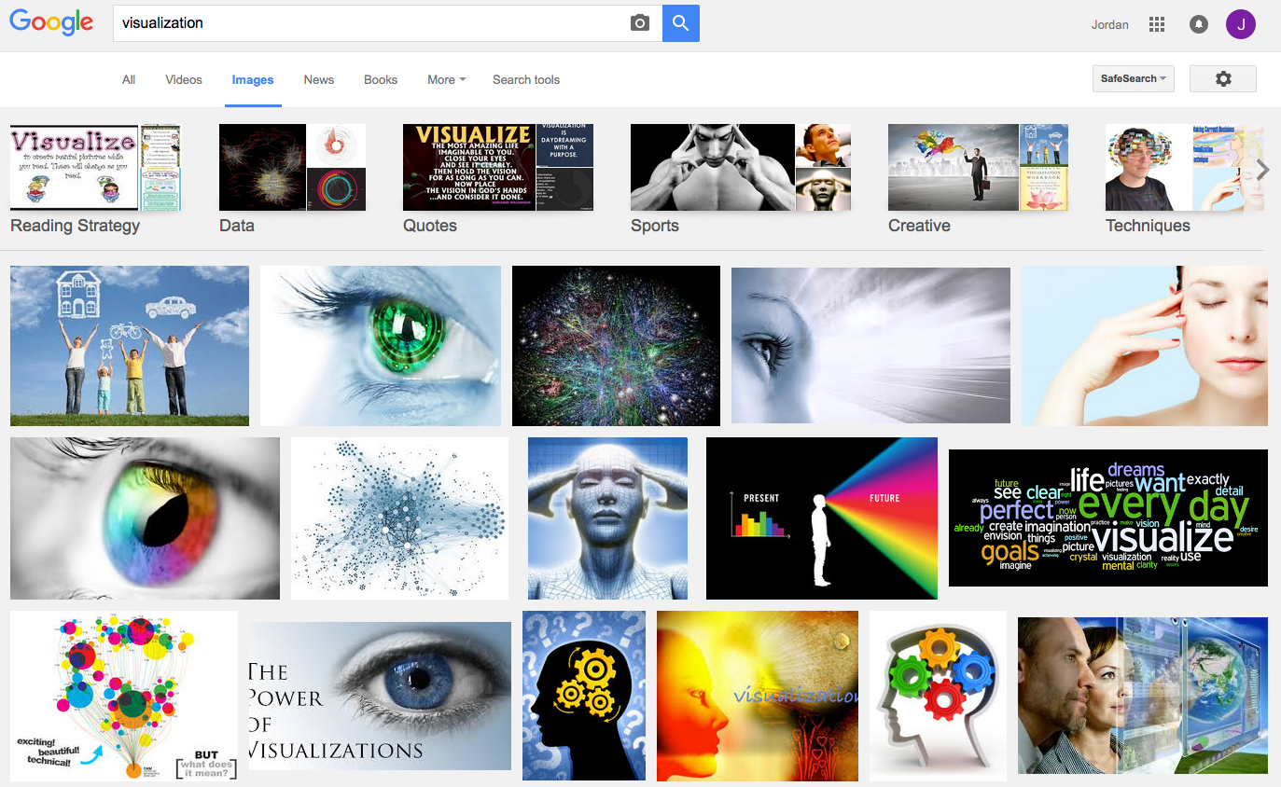
What is visualization?

Slide 6
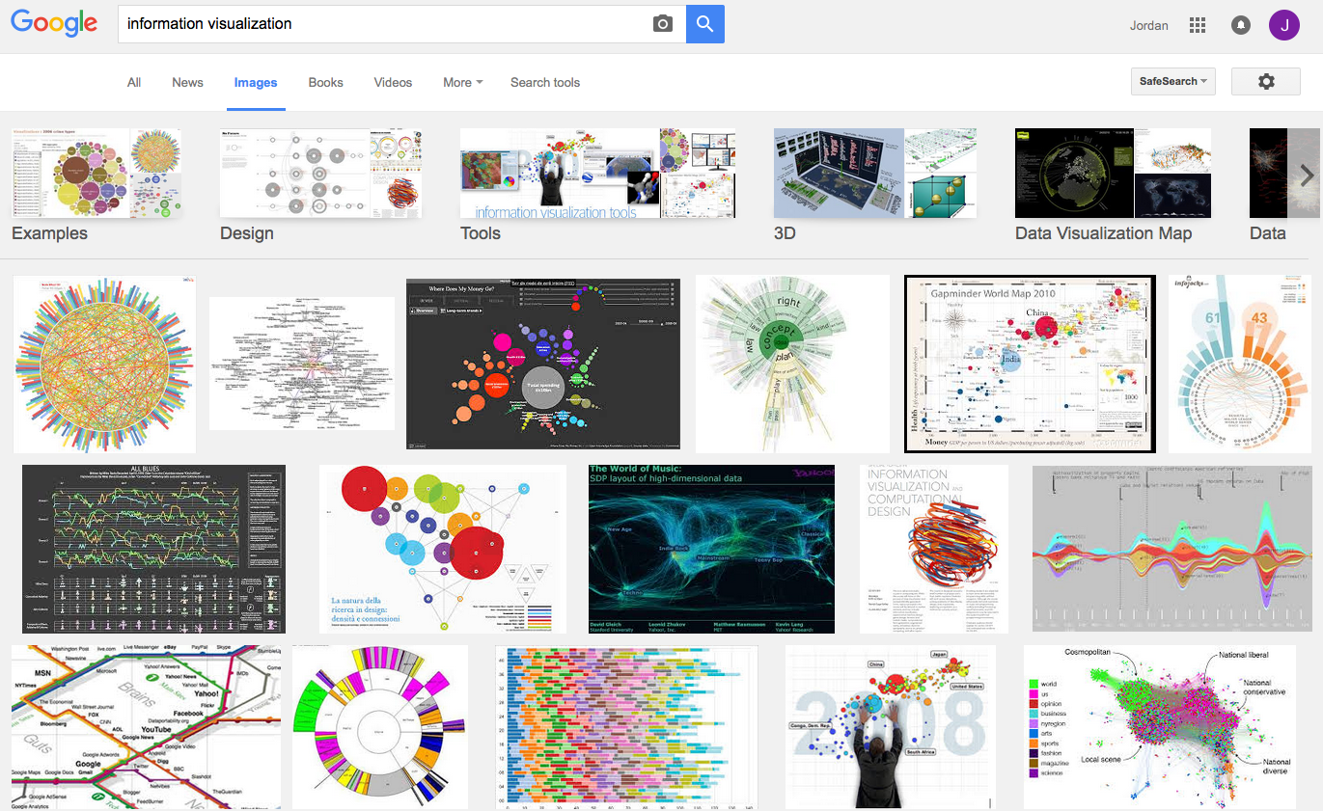
What is visualization?

Slide 7
Perhaps a more helpful question:
What are some ways
a “visualization” can be useful?

Slide 8
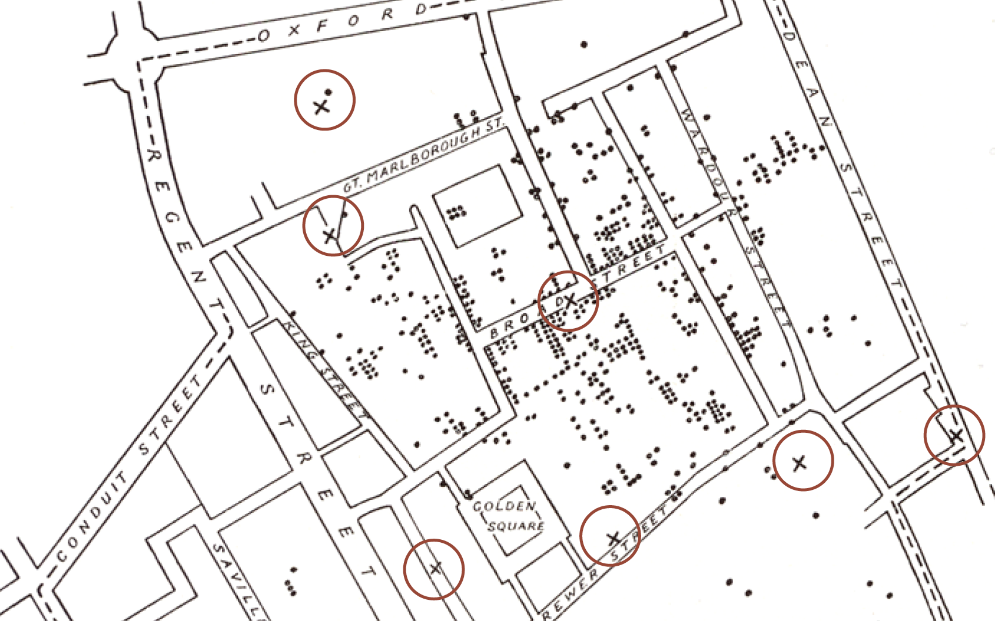
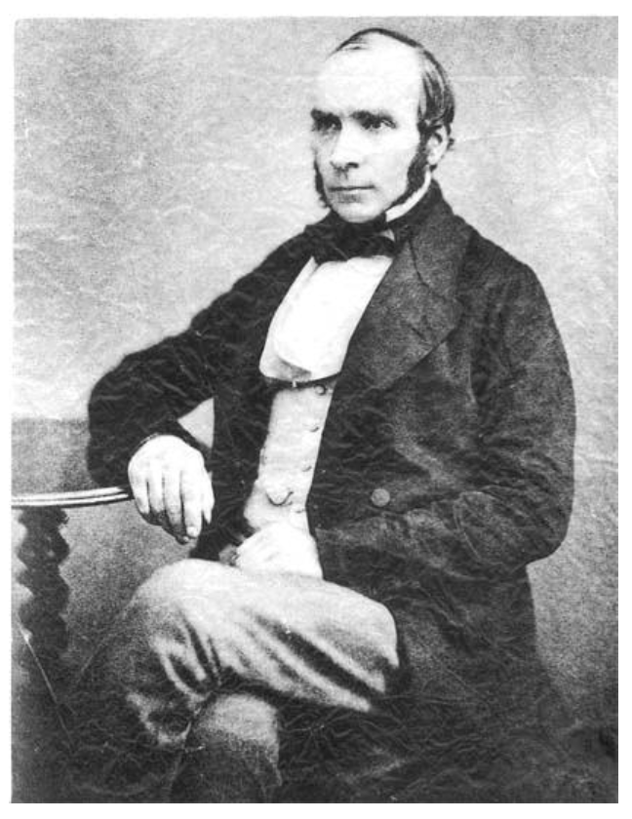
Does it help you spot trends?
In 1854, cholera broke out in London
127 people near Broad St. died within 3 days
616 people died within 30 days
Initial explanation:
“Miasma in the atmosphere”
Dr. John Snow was the first to link the outbreak to contaminated water
How did he do it?
Talked to local residents
Identified a water pump as a likely source
Used maps to illustrate his theory
Convinced authorities to disable the pump
More info here: http://en.wikipedia.org/wiki/1854_Broad_Street_cholera_outbreak

Slide 9
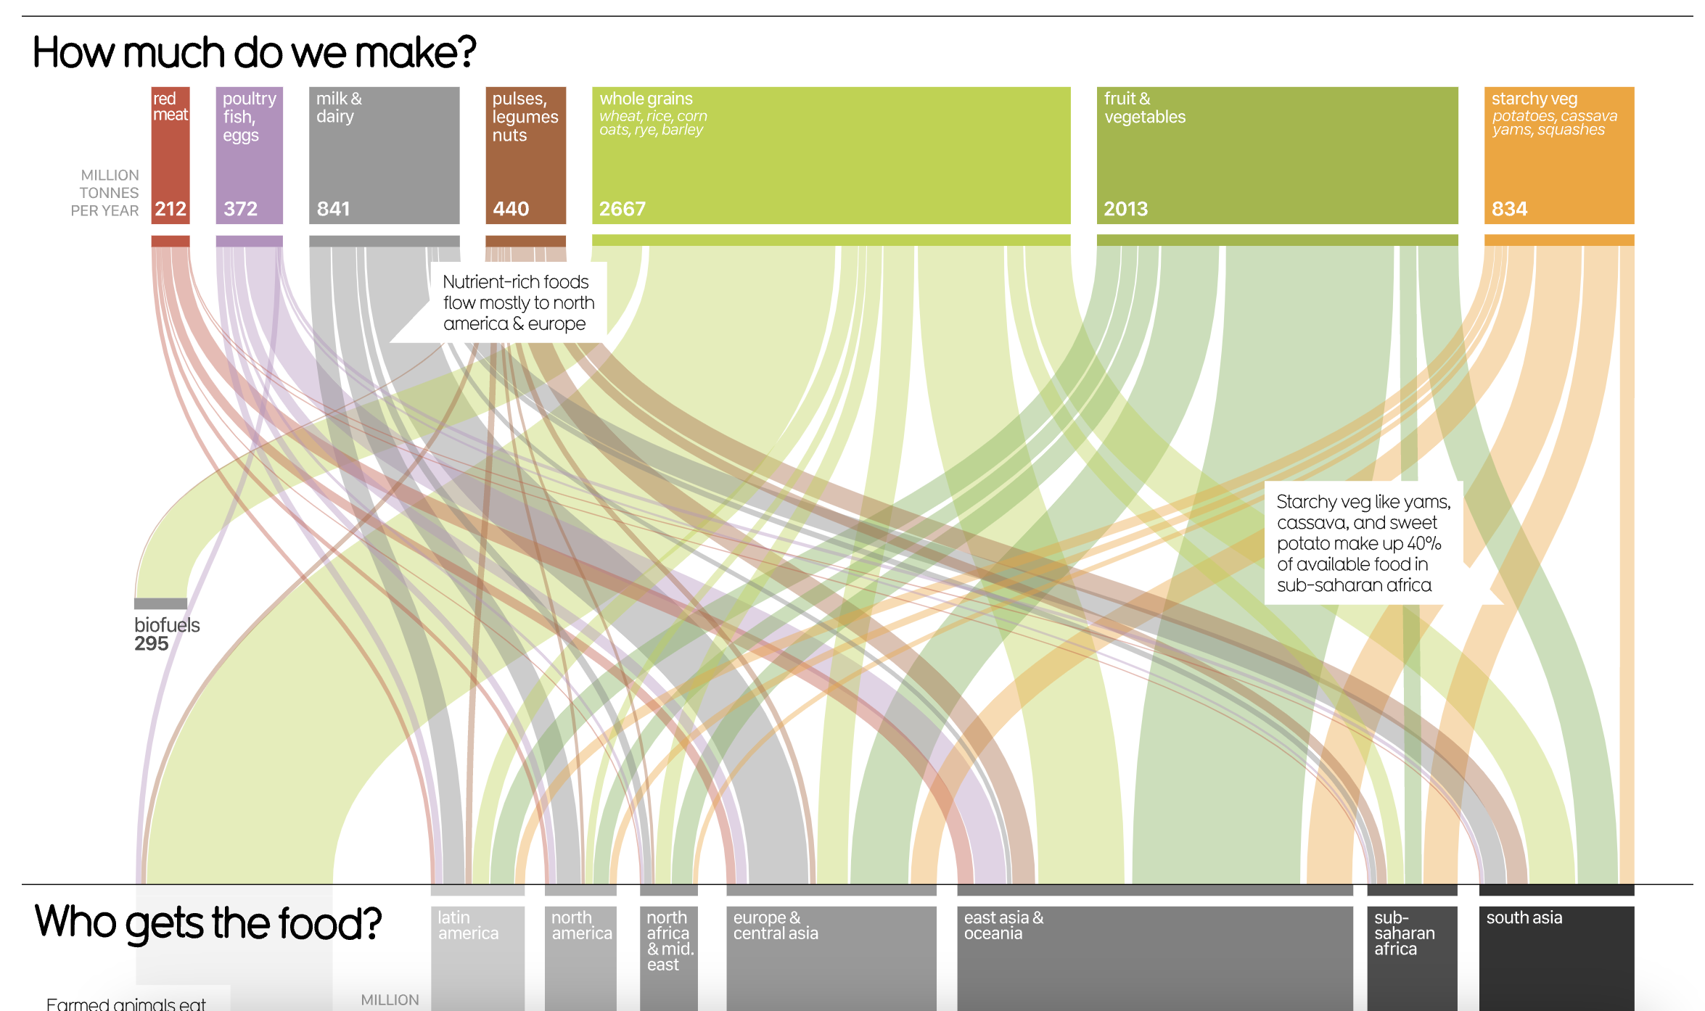
Does it help you explore?
https://informationisbeautiful.net/visualizations/global-food-supply-where-does-all-the-worlds-food-go/

Slide 10

Does it tell a story?
Hans Rosling’s 200 Countries, 200 Years, 4 Minutes – The Joy of Stats – BBC Four
https://www.youtube.com/watch?v=jbkSRLYSojo

Slide 11
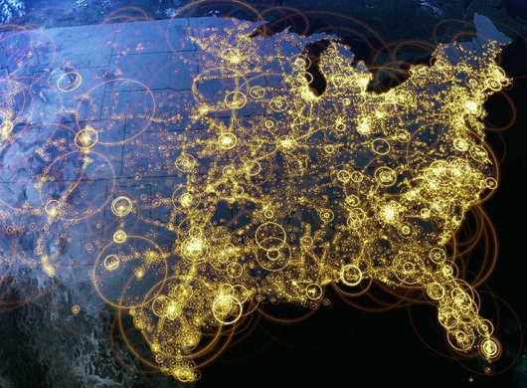
Visualization (def.)
Visual representations of data that reinforce human cognition
Notes:
Image from StackOverflow: http://i.stack.imgur.com/hbO8v.jpg

Slide 12

Wait… what is “data”?

Slide 13

Data: a definition
Data is a set of variables that capture various aspects of the world:
Tuition rates,
enrollment numbers,
public vs. private, etc.

Slide 14

Data: a definition
A dataset also contains a set of observations (also called records) over these variables. For example:
tuition = $46,288,
enrollment = 2,563,
private, etc.

Slide 15


A dataset also contains a set of observations (also called records) over these variables. For example:
Data: a definition
tuition = $16,115,
enrollment = 28,635,
public, etc.

Slide 16
One way to think about this:
VARIABLES
 | Tuition | Enrollment | Public vs. Private | …
Smith College | $46,288 | 2,563 | private
UMass Amherst | $16,115 | 28,635 | public
Hampshire College | $48,065 | 1,400 | private
Mount Holyoke College | $43,886 | 2,189 | private
Amherst College | $50,562 | 1,792 | private
⋮
OBSERVATIONS

Slide 17
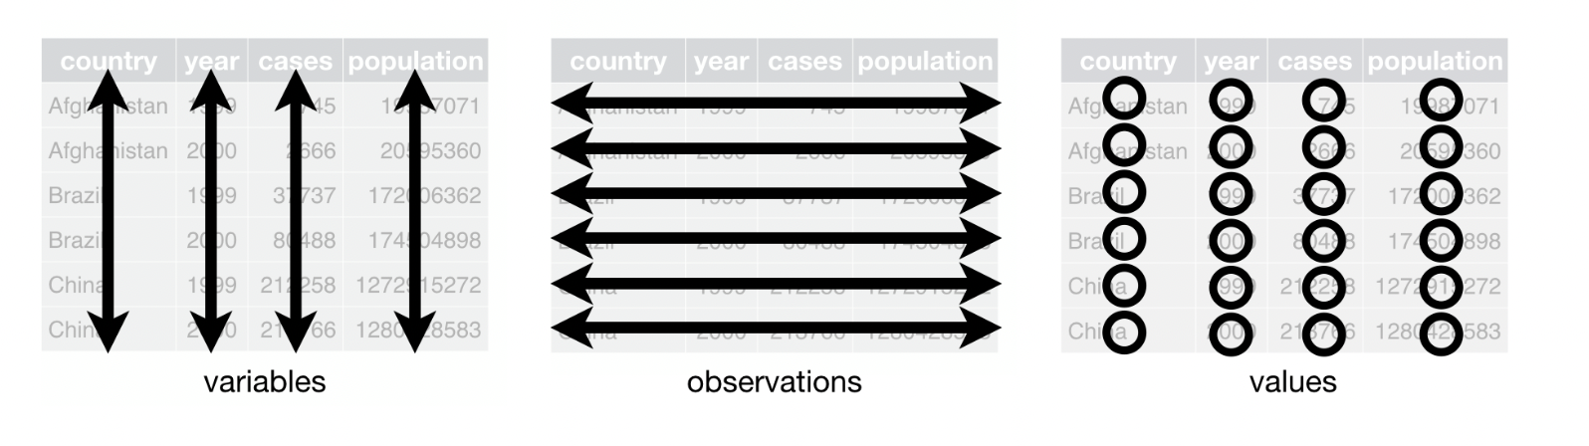
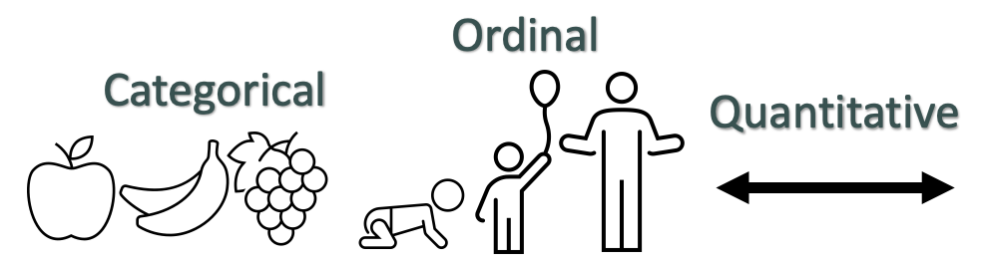
Data
Remember…

Slide 18
Data → Visuals
Remember…
Big idea behind visualization
Data have dimensions
Visualizations have dimensions, too
To build good visualizations, we need to map data dimensions to visual dimensions in a principled way

Slide 19
Data → Visuals
Remember…
Big idea behind visualization
Data have dimensions
Visualizations have dimensions, too
To build good visualizations, we need to map data dimensions to visual dimensions in a principled way

Slide 20
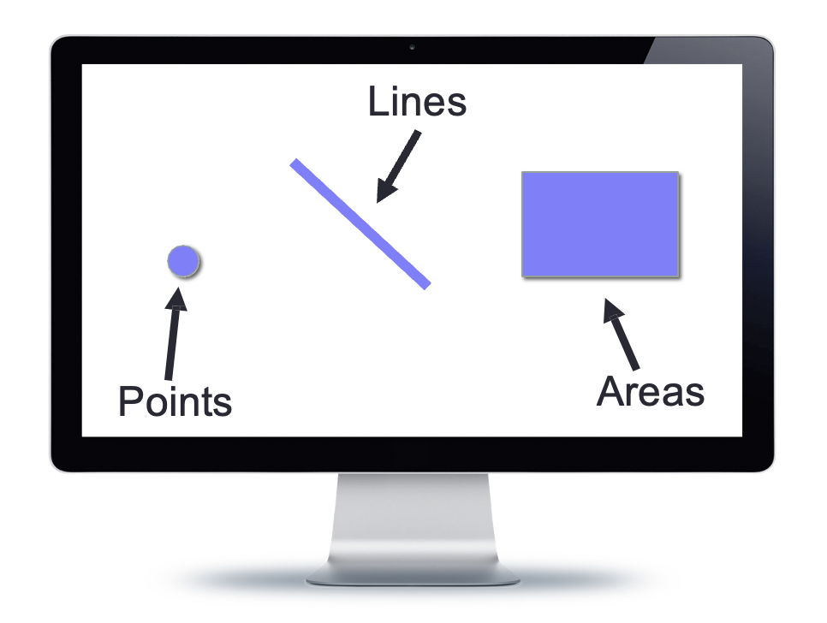
Data → Visuals
Data
Visuals
Marks
The “ink”

Slide 21
Data → Visuals
Data
Visuals
Marks
The “ink”
Channels or dimensions
How the marks show up on the page

Slide 22
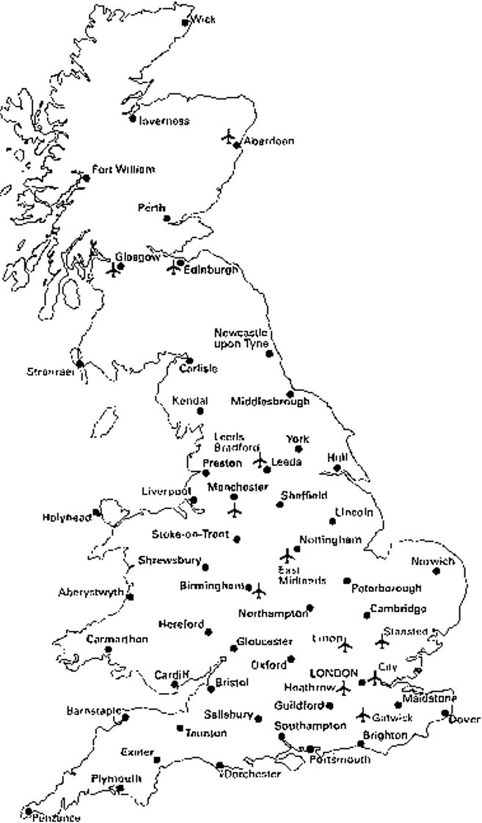
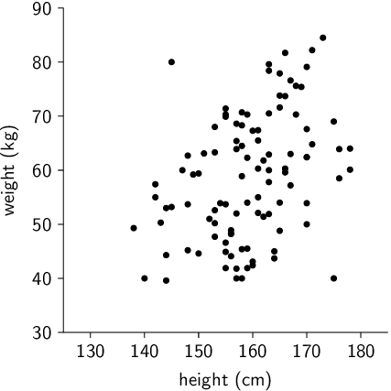
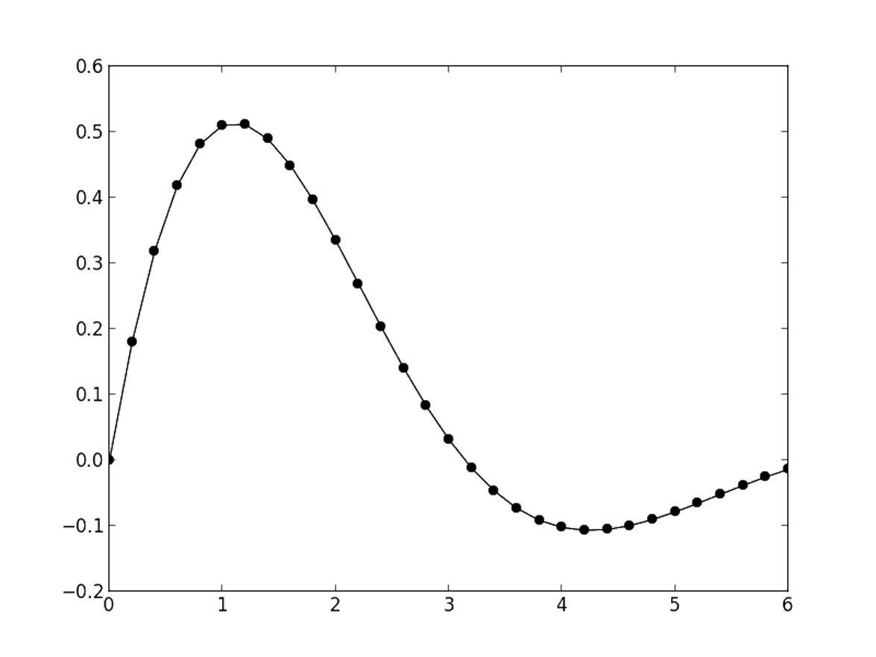
Visual Channels / Dimensions
Position
Encode information using where mark is drawn
Ex.

Slide 23
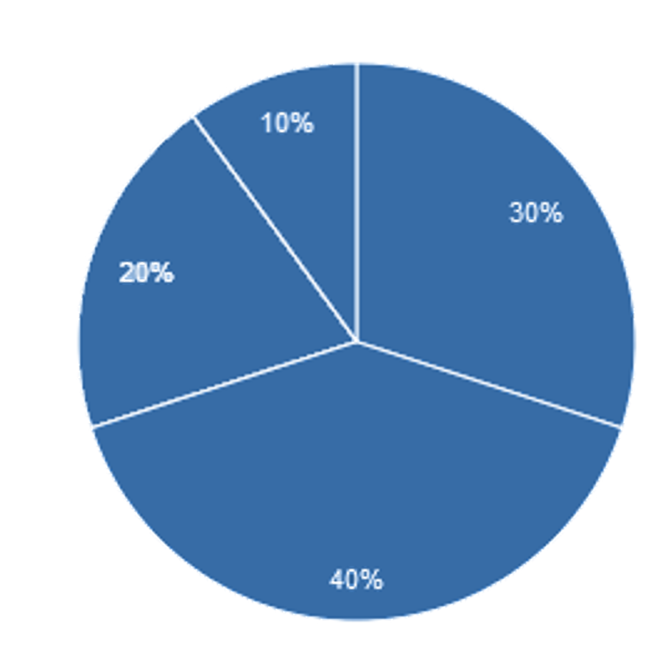
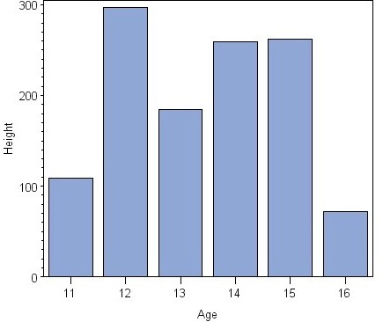
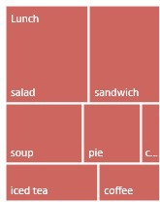
Visual Channels / Dimensions
Size
Encode information using how big mark is drawn
Ex.

Slide 24
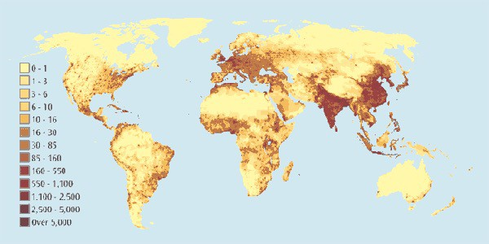
Visual Channels / Dimensions
Value
Encode information using how dark mark is drawn
Ex.

Slide 25
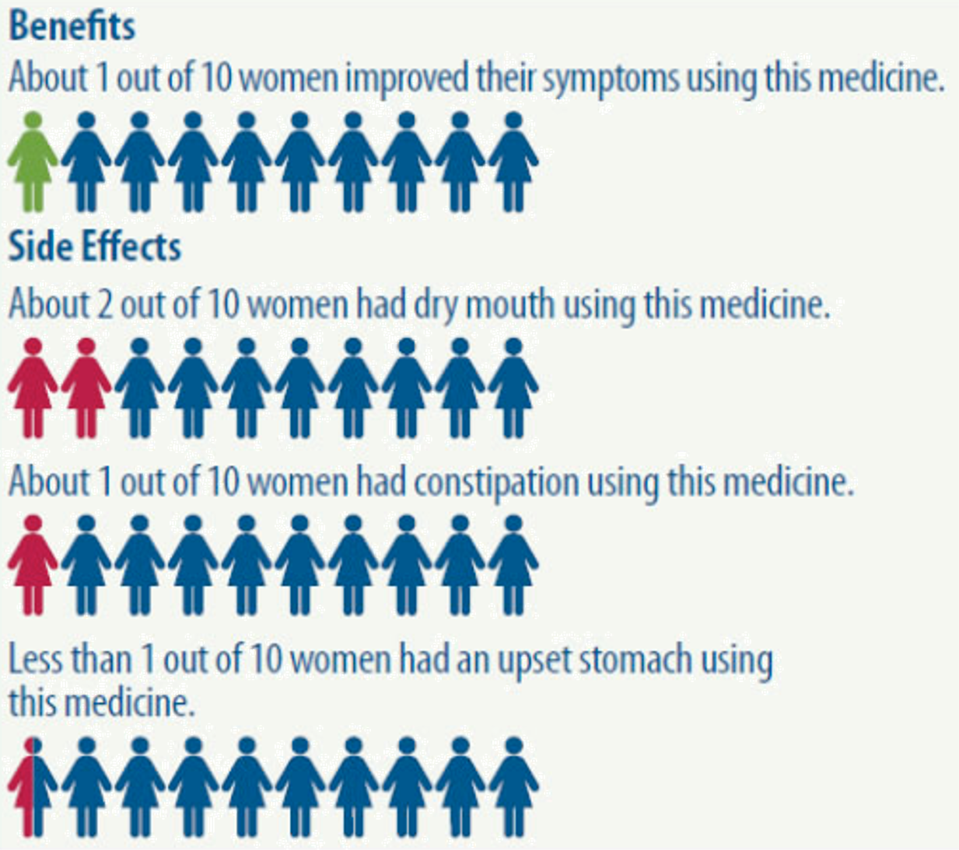
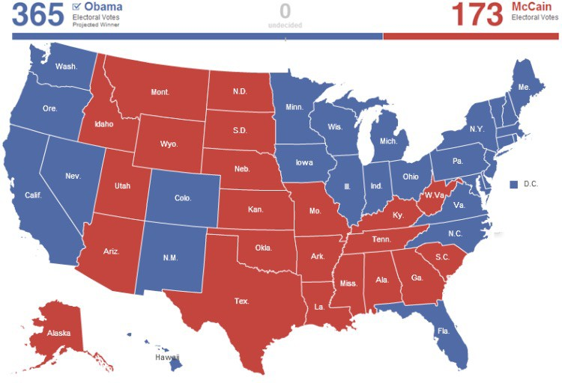
Visual Channels / Dimensions
Color
Encode information using hue of mark
Ex.

Slide 26
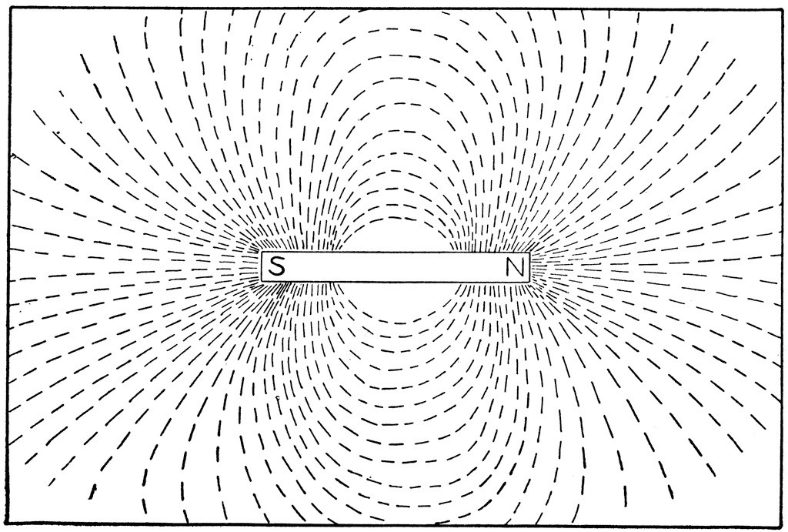
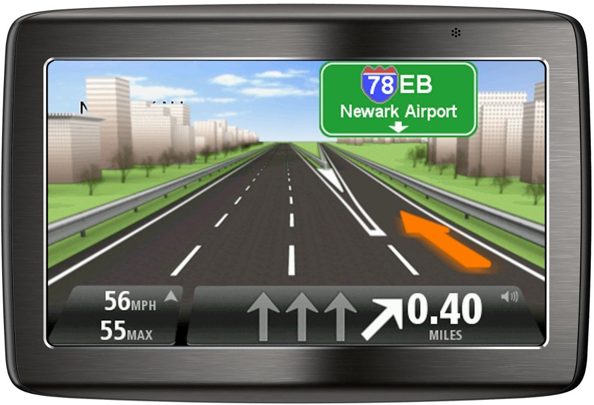
Visual Channels / Dimensions
Orientation
Encode information using how mark is rotated
Ex.

Slide 27



Visual Channels / Dimensions
Shape
Encode information using how mark is shaped
Ex.

Slide 28
Data → Visuals
Remember… Big idea behind visualization
Map data dimensions to visual dimensions in a principled way

Slide 29
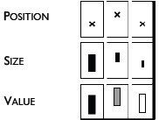

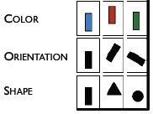
Data → Visuals
Remember… Big idea behind visualization
Map data dimensions to visual dimensions in a principled way

Slide 30

Data → Visuals
Remember… Big idea behind visualization
Map data dimensions to visual dimensions in a principled way
Not all visual dimensions can represent all data types
Jacques Bertin, Semiologie Graphique
(Semiology of Graphics), 1967.

Slide 31
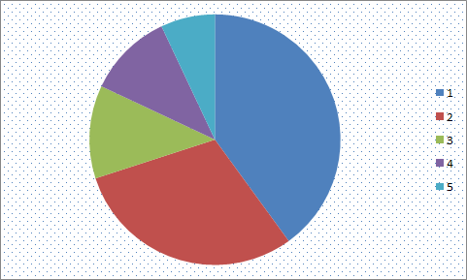
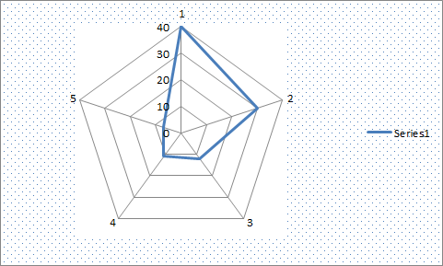
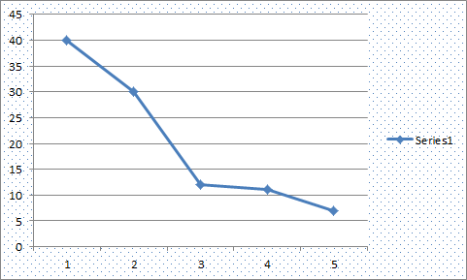
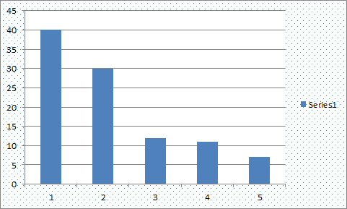
Key question for this course
Which data dimension should be mapped
to which visual dimension?

Slide 32
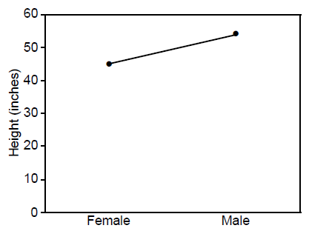
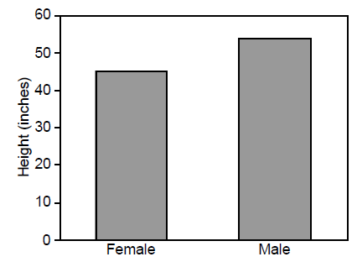
Answer: it depends
Average Height for Youth Sports Participants
Gymnastics Basketball
Gymnastics Basketball

Slide 33
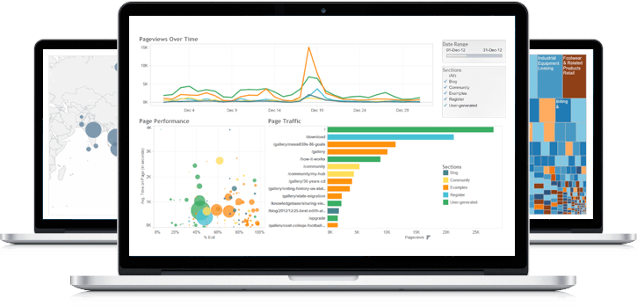
A sampling of visualization techniques

Slide 34
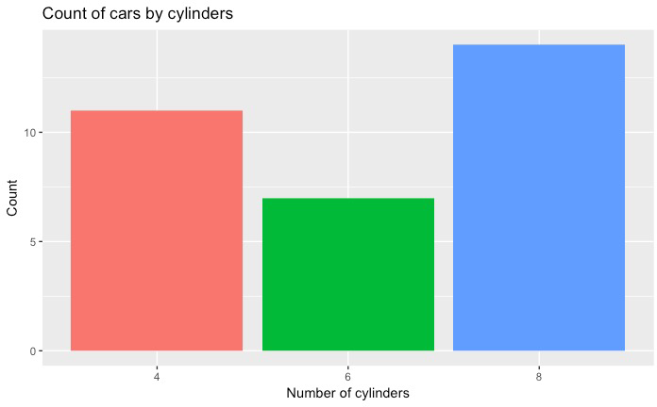
Used to show quantitative variable X categorical variable
Compares quantitative values for different categories
Highlights relative amounts
Grouped/stacked bars can break each category into sub-groups
What is the data visual mapping in this chart?
Bar chart

Slide 35
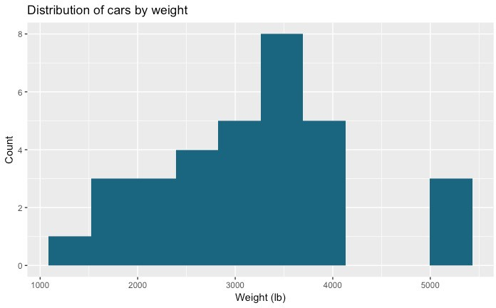
Used for one quantitative variable
Looks like a bar chart… but the x-axis consists of equal size ranges (bins) for the quantitative variable
Y-axis shows count or relative frequency
Highlights distribution
Note: bin size makes a big difference!
What is the data visual mapping in this chart?
Histogram
10-14
25-29
45-49
50-54
20-24
30-34
40-44
15-19
35-39

Slide 36
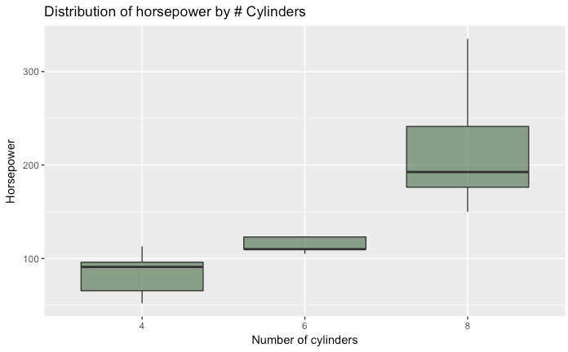
What is the data visual mapping in this chart?
Used for one quantitative variable
Also useful for highlighting distribution
Calls out key values:
median
1st & 3rd quartiles
“fences”
outliers
Boxplot
“fence” (1.5IQR)
₃rd quartile
outlier
median
₁st quartile

Slide 37
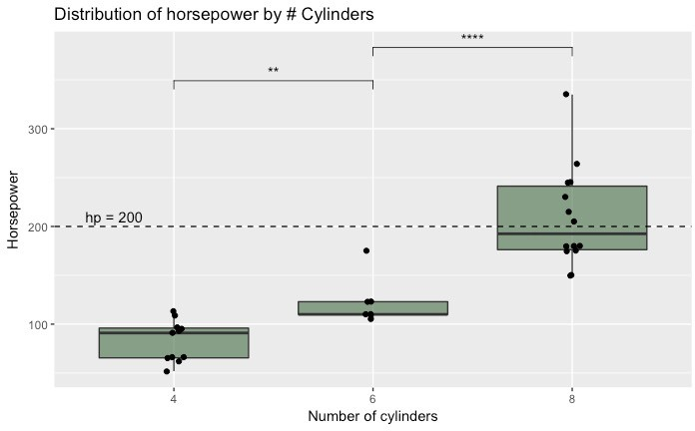
Use “jitter” to show actual values
Reference lines can help provide context
Can use annotations to show statistical significance
Boxplot

Slide 38
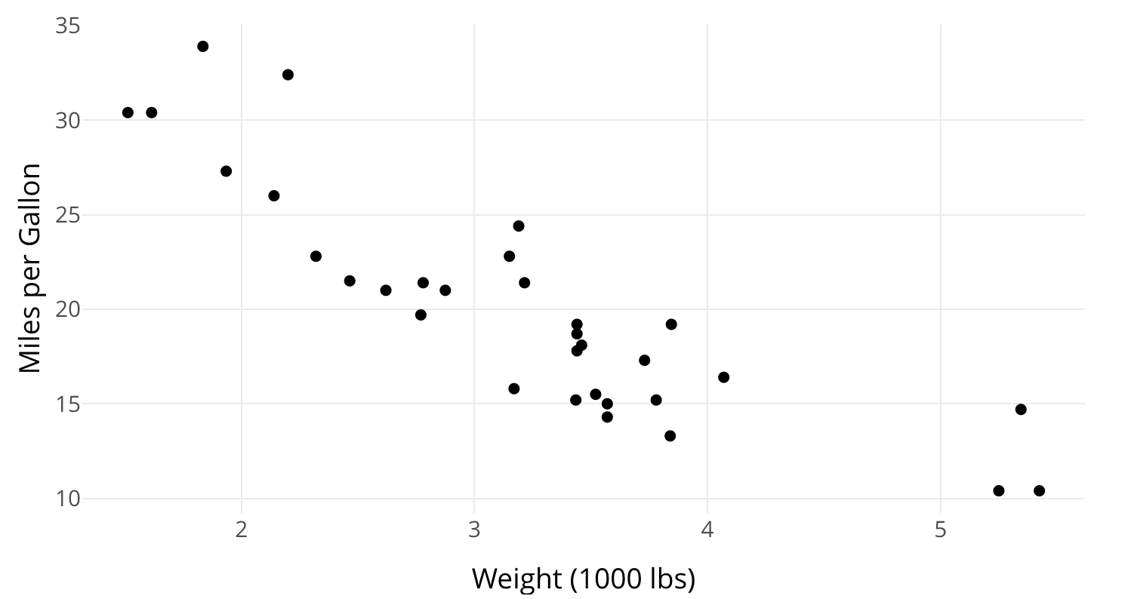
Used to show one quantitative variable X one quantitative variable
Shows the relationship between the two variables
Each point in the plot represents an observation
What is the data visual mapping in this chart?
Scatterplot

Slide 39
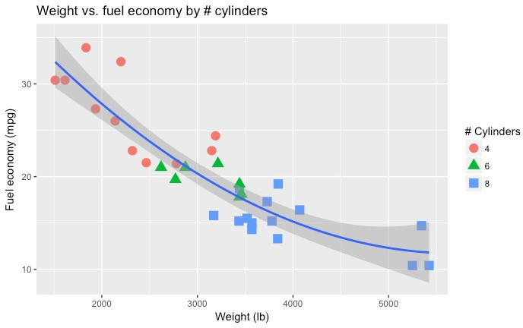
Can use color or symbol to show one quantitative variable X one quantitative variable X one categorical variable
This highlights groups
Sometimes useful to show a trend line (regression)
What is the data visual mapping in this chart?
Scatterplot

Slide 40
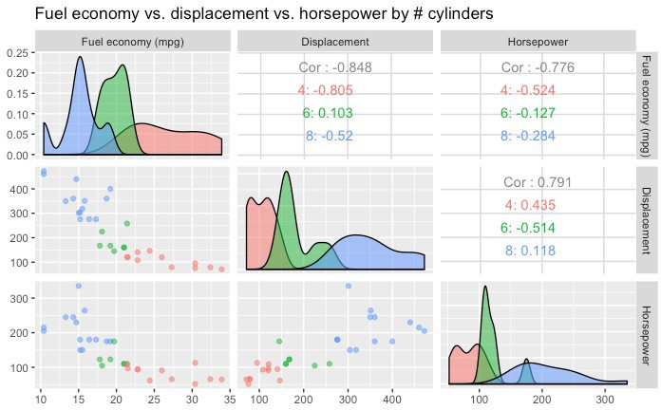
Can use to show many combinations of one quantitative variable X one quantitative variable
Combines multiple scatterplots into a matrix to show additional relationships
Scatterplot matrix (SPLOM)

Slide 41
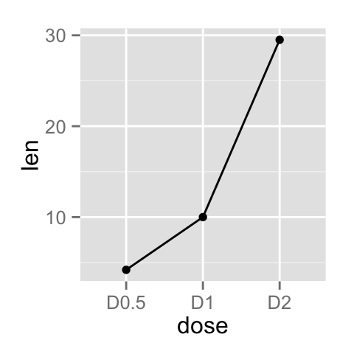
What is the data visual mapping in this chart?
Shows the trend of one quantitative variable, often over time
Line chart

Slide 42
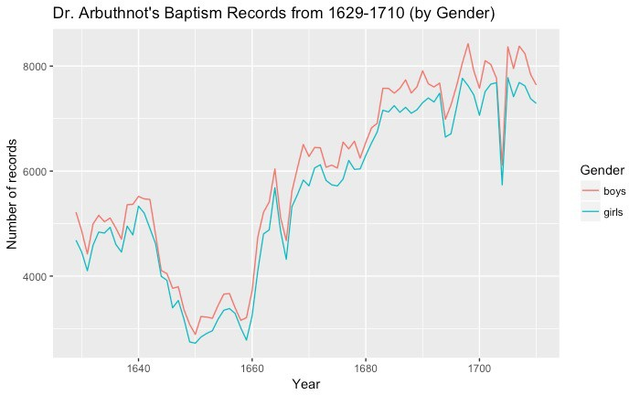
Multiple lines allow comparison of trends
Can show one quantitative variable across groups, or multiple quantitative variables (if they have the same scale)
Highlights “position switches”
Line chart

Slide 43
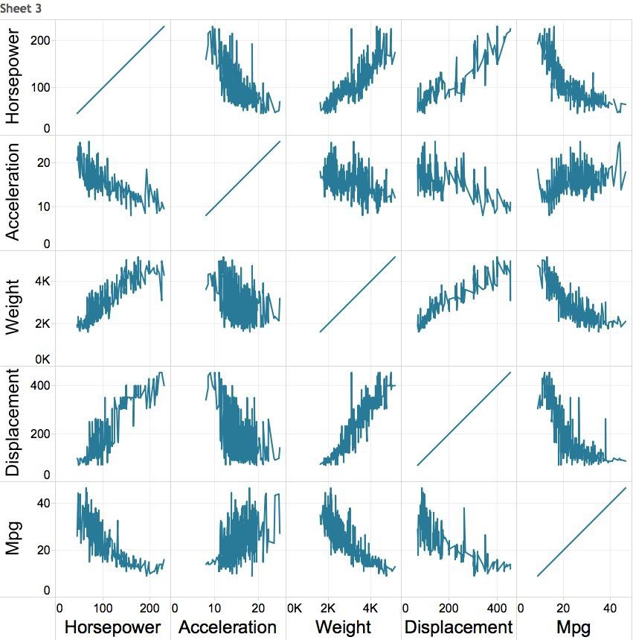

Multiple variables: line chart matrix?

Slide 44
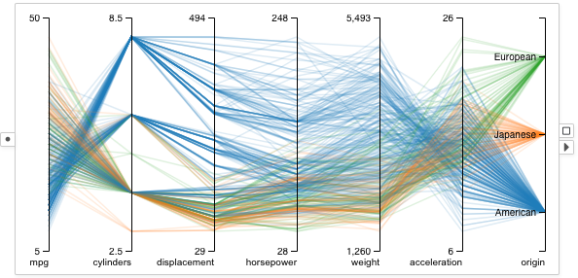
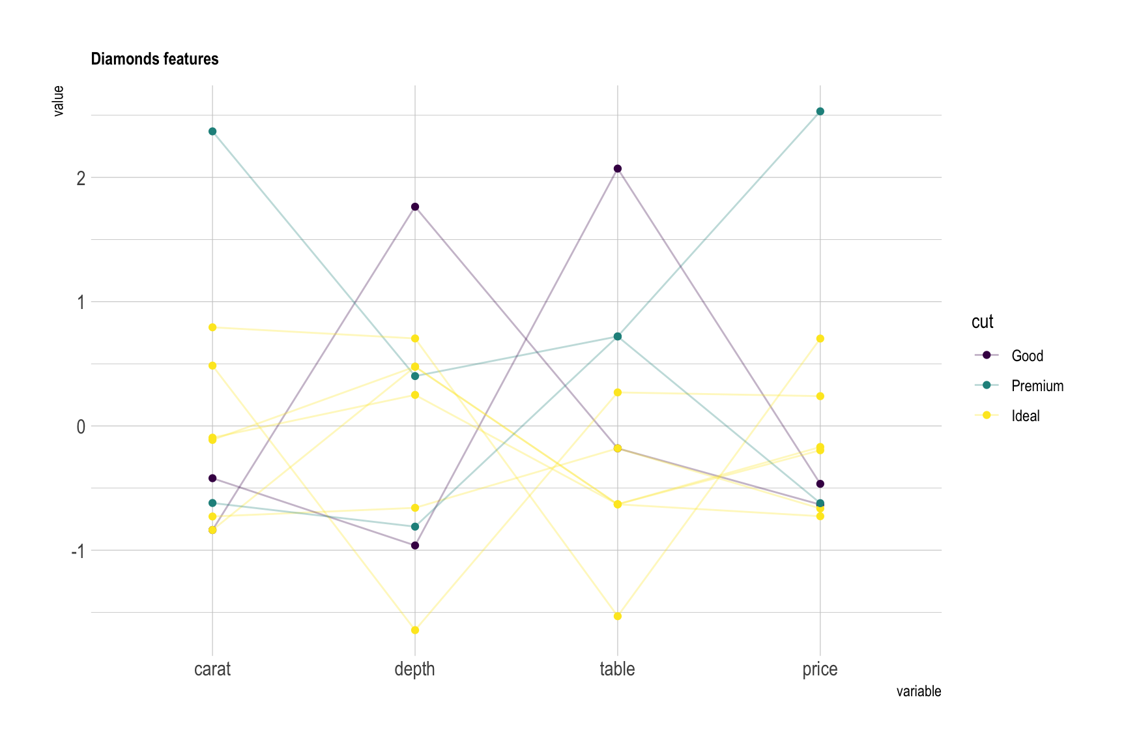
Supports (pairwise) comparison of a collection of quantitative variables
Each axis represents one variable
They may have different scales, typically you normalize them
Each line represents one observation (connecting the associated values along each axis)
Axis order matters!
Parallel Coordinates Plot
https://visflow.org/node/visualization/parallel-coordinates.html
https://www.data-to-viz.com/graph/parallel.html

Slide 45
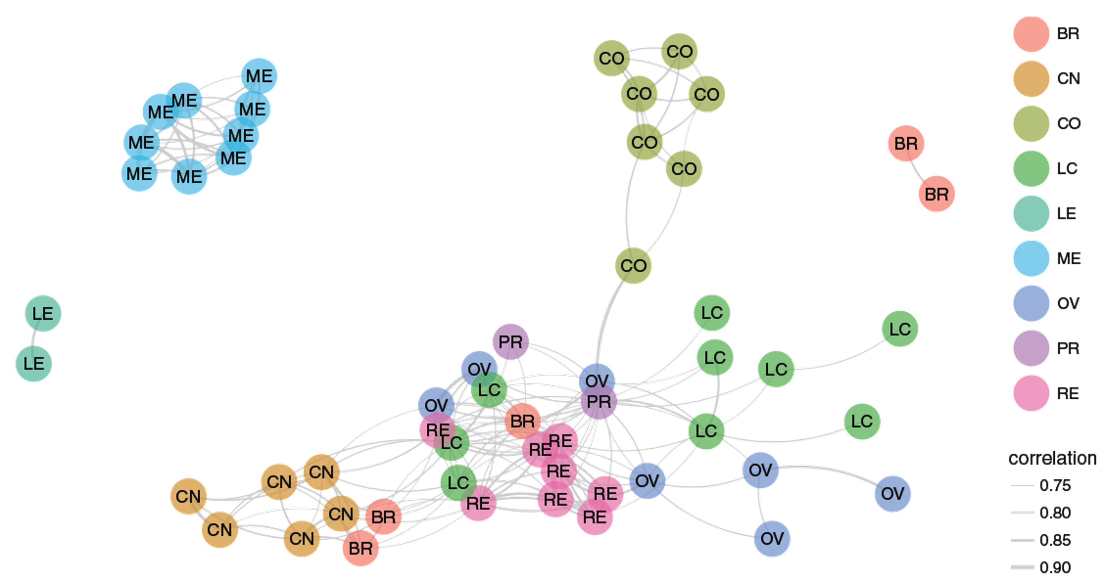
What is the data visual mapping in this chart?
Shows graph data
Useful for showing the relationships between entities
Can use color, size, etc. to encode additional information
Caveat: network diagrams quickly become hairballs for large, dense data
Network

Slide 46
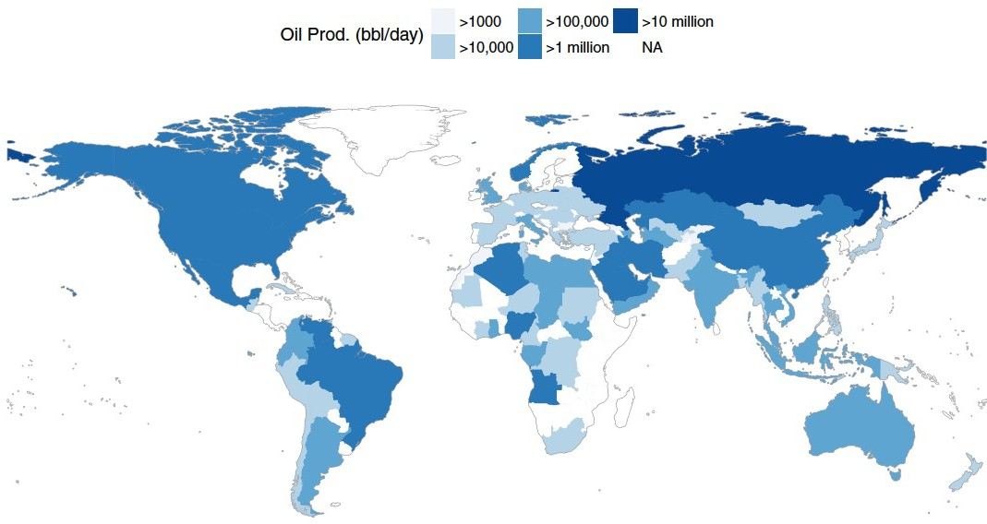
Shows geographic (spatial) data
Useful for analysis with a strong geographic component
Filled maps (choropleth) vs. points
Remember: color scale comparisons are harder for humans than size comparisons!
What is the data visual mapping in this chart?
Map

Slide 47
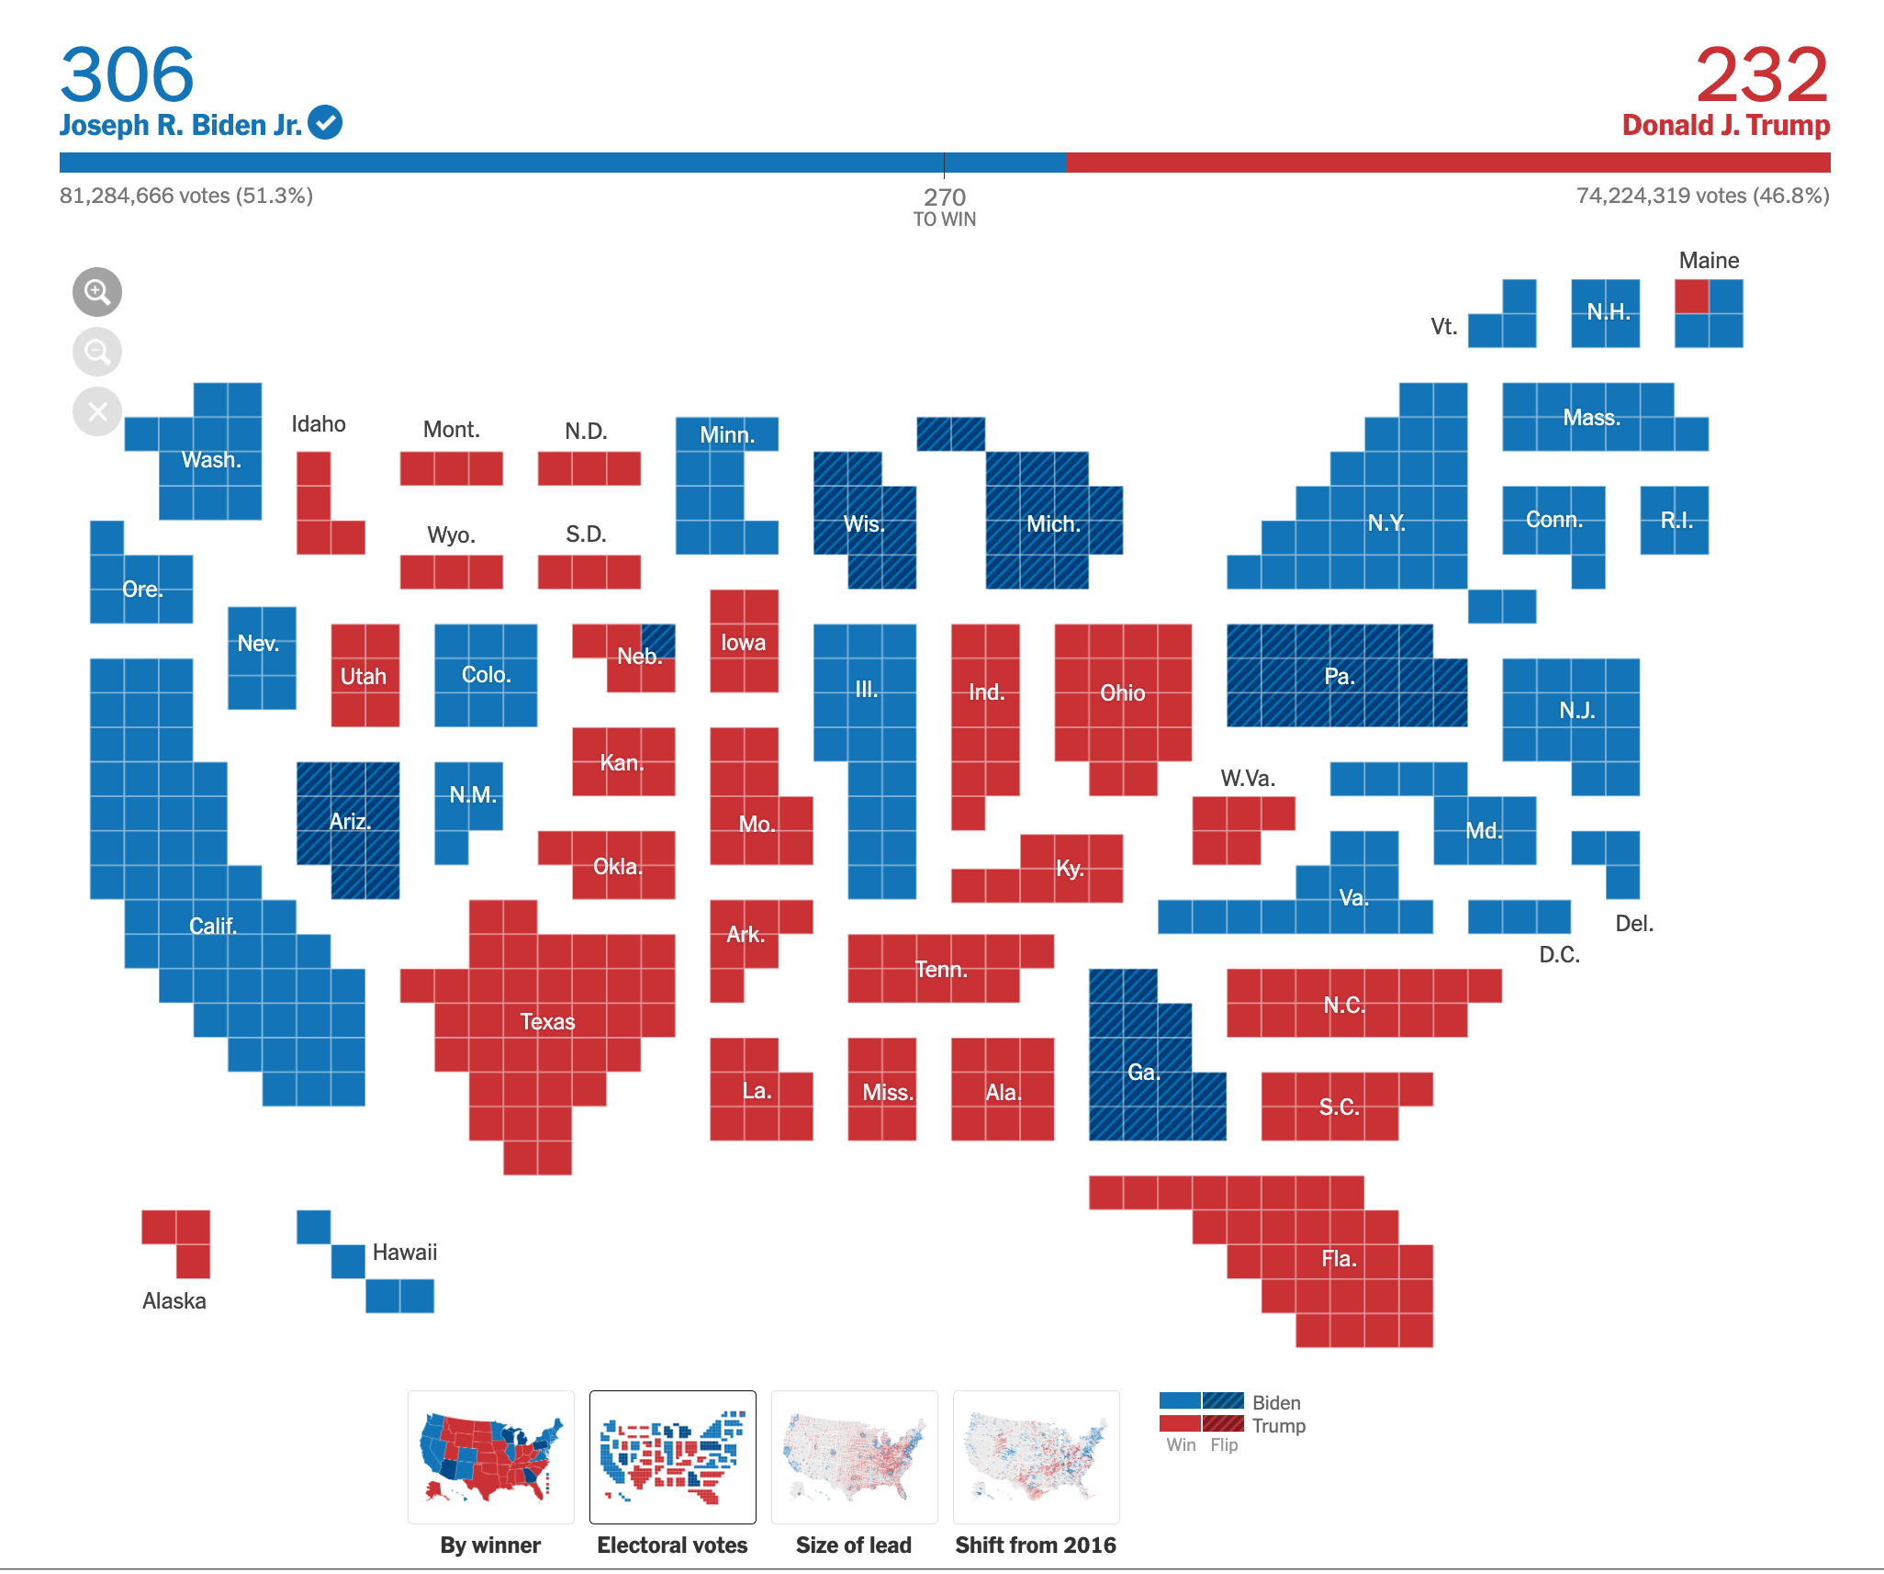
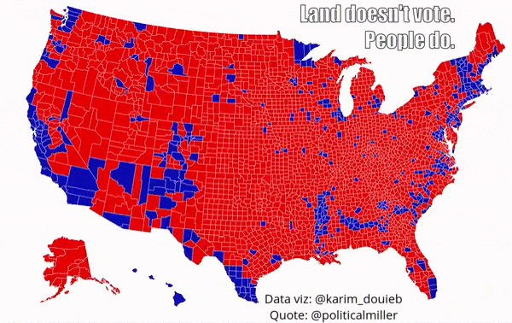
Remember to map the correct data to your visual channels
Map

Slide 48
Your turn
Work with 1-2 classmates
Download nyc_trees.csv from the course website.
Data is a subset of the dataset available here: https://data.cityofnewyork.us/Environment/2015-Street-Tree-Census-Tree-Data/uvpi-gqnh/about_data
Using R or Python (you pick!) and nyc_trees.csv generate a:
Bar chart
Histogram
Scatterplot
If you have time, try a Boxplot and Linechart
R Plotting Resources:
https://r4ds.hadley.nz/layers
https://r-graphics.org/
https://r-graph-gallery.com/ggplot2-package.html
Python Plotting Resources:
https://matplotlib.org/
https://plot.ly/python/
https://seaborn.pydata.org/tutorial.html

